Slide 1
A Seminar on Cloud Computing
Presented by
Indranil & Pravin

Slide 2
Introduction
Cloud Computing provides us a means by which we can access the applications as utilities, over the Internet. It allows us to create, configure, and customize applications online.
With Cloud Computing users can access database resources via the internet from anywhere for as long as they need without worrying about any maintenance or management of actual resources.
Notes:
How presentation will benefit audience: Adult learners are more interested in a subject if they know how or why it is important to them.
Presenter’s level of expertise in the subject: Briefly state your credentials in this area, or explain why participants should listen to you.

Slide 3

What is Cloud ?

Slide 4
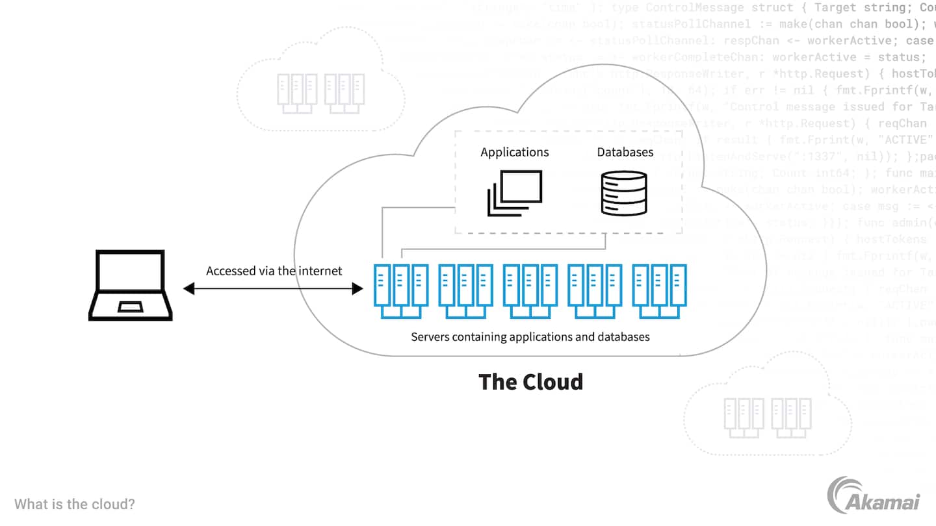
Cloud
The term Cloud refers to a Network or Internet.
In other words, we can say that Cloud is something, which is present at remote location.
Cloud can provide services over network, i.e.,
on public networks or on private networks, i.e., WAN, LAN or VPN.
Applications such as e-mail, web conferencing, customer relationship management (CRM), all run in cloud.

Slide 5


What is Cloud Computing?

Slide 6

Cloud Computing
Cloud Computing refers to manipulating, configuring, and accessing the applications online.
It offers online data storage, infrastructure and application.
Cloud Computing is both a combination of software and hardware-based computing resources delivered as a network service.

Slide 7
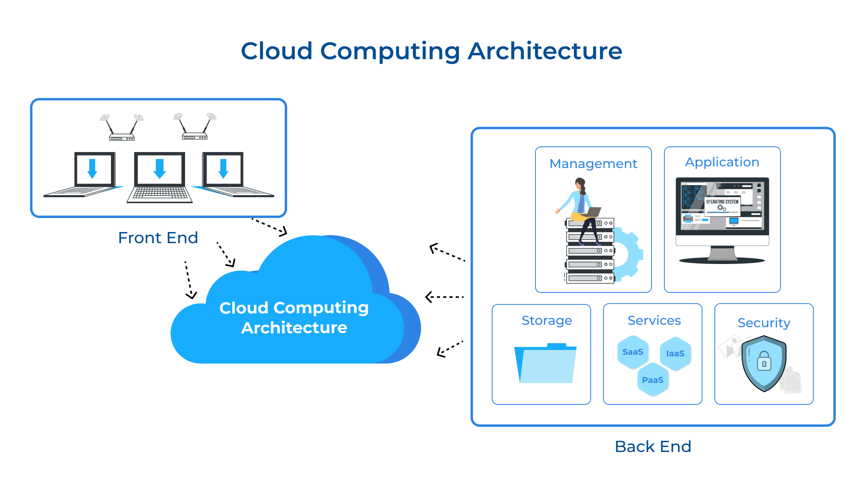
Lesson 1: Objectives
Notes:
Example objectives
At the end of this lesson, you will be able to:
Save files to the team Web server.
Move files to different locations on the team Web server.
Share files on the team Web server.

Slide 8
Basic Concepts
There are certain services and models working behind the scene making the cloud computing feasible and accessible to end users.
Following are the working models for cloud computing:
Deployment Models
Service Models

Slide 9
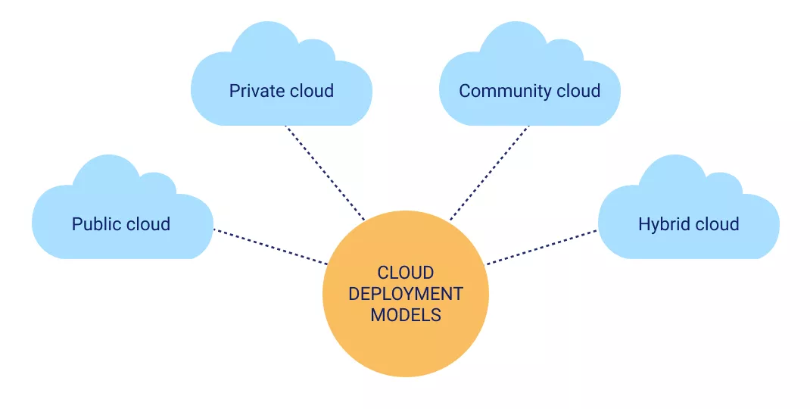
Deployment Models
Deployment models define the type of access to the cloud, i.e., how the cloud is located ? Cloud can have any of the four types of access:
Public
Private
Hybrid
Community

Slide 10
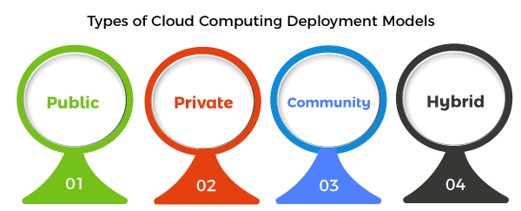
PUBLIC CLOUD: The Public Cloud allows systems and services to be easily accessible to the general public. Public cloud may be less secure because of its openness, e.g., e-mail.
PRIVATE CLOUD: The Private Cloud allows systems and services to be accessible within an organization. It offers increased security because of its private nature.
COMMUNITY CLOUD: The Community Cloud allows systems and services to be accessible by group of organizations.
HYBRID CLOUD: The Hybrid Cloud is mixture of public and private cloud. However, the critical activities are performed using private cloud while the non-critical activities are performed using public cloud.

Slide 11
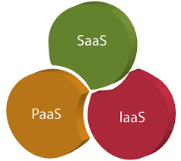
Service Models
Service Models are the reference models on which the Cloud Computing is based. These can be categorized into three basic service models as listed below
IaaS
PaaS
SaaS

Slide 12
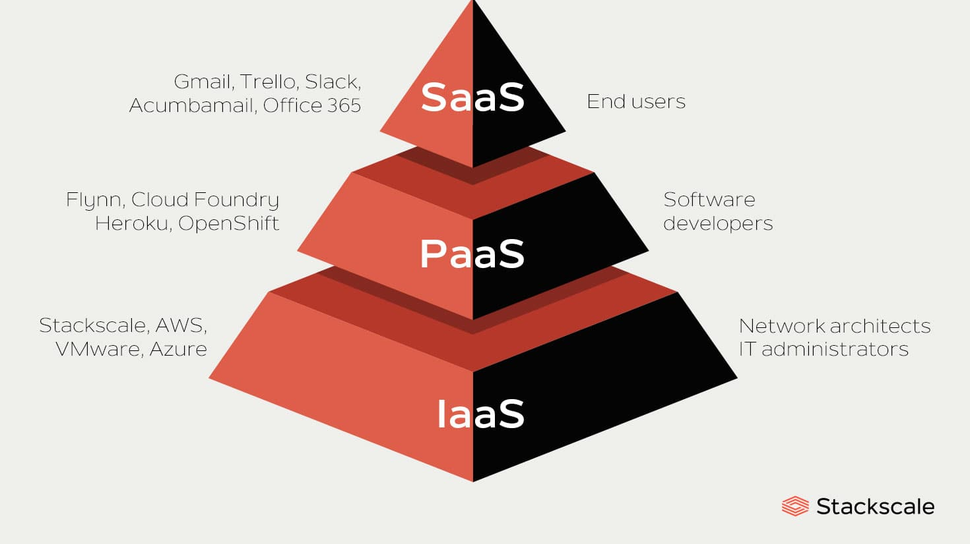

Slide 13
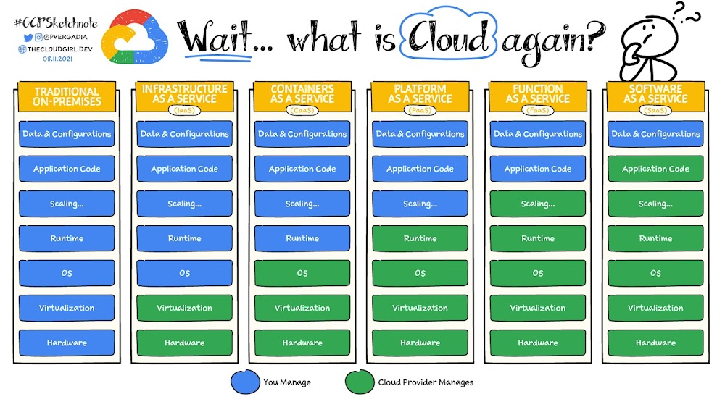

Slide 14
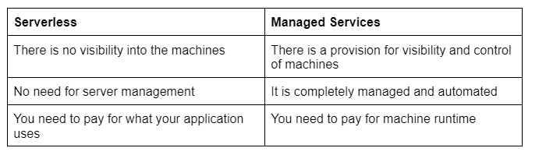
Serverless Vs Managed Services -

Slide 15
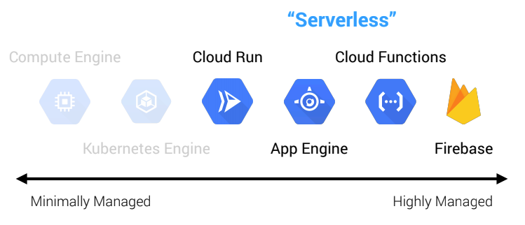

Slide 16
Infrastructure as a Service(IaaS)
IaaS is the delivery of technology infrastructure as an on demand scalable service.
IaaS provides access to fundamental resources such as physical machines, virtual machines, virtual storage, etc.
Usually billed based on usage
Usually, multi-tenant virtualized environment
Can be coupled with Managed Services for OS and application support

Slide 17
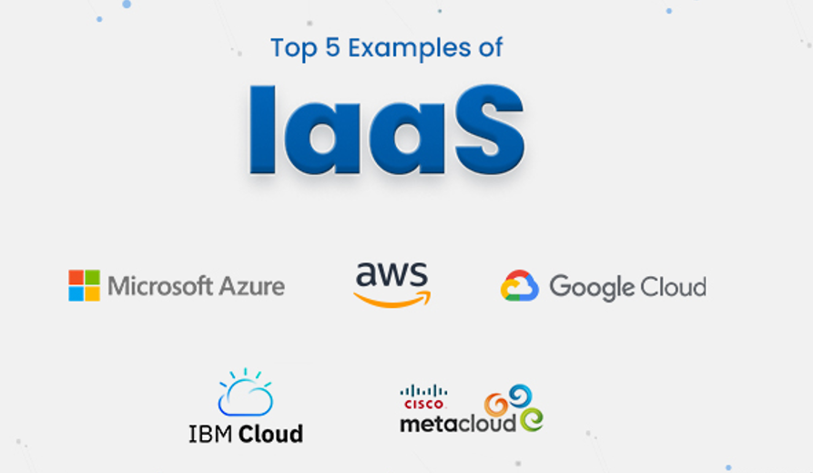
IaaS Examples

Slide 18
Platform as a Service
PaaS provides the runtime environment for applications, development & deployment tools, etc.
PaaS provides all the facilities required to support the complete life cycle of building and delivering web applications and services entirely from the Internet.
Typically, applications must be developed with a particular platform in mind
Multi-tenant environments
Highly scalable multi-tier architecture

Slide 19
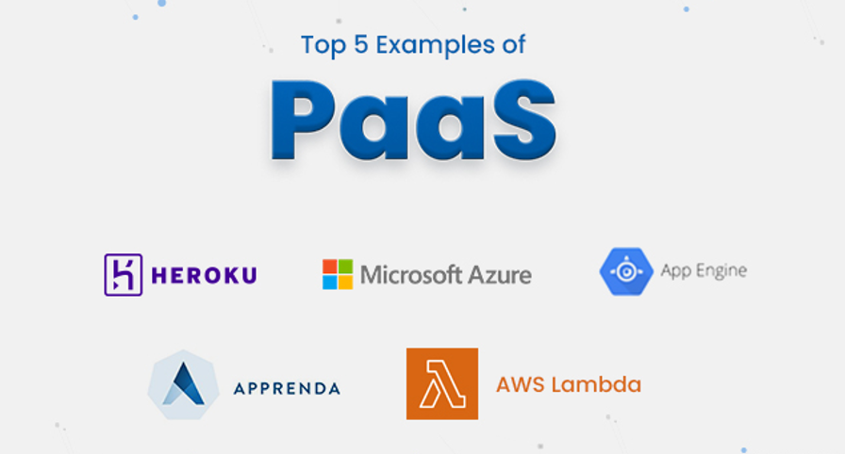
PaaS Examples

Slide 20
Software as a Service
SaaS model allows to use software applications as a service to end users.
SaaS is a Software delivery methodology that provides licenced multi-tenant access to software and its functions remotely as a Web based service.
Usually billed based on usage
Usually, multi-tenant environment
Highly Scalable architecture

Slide 21
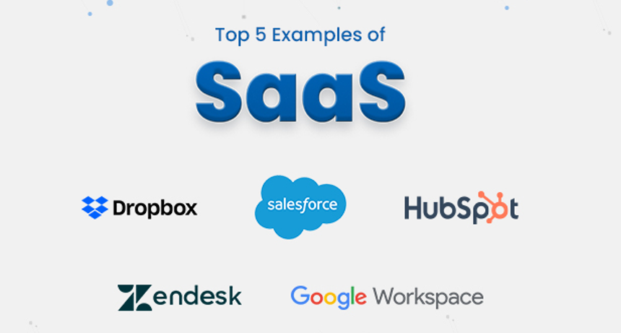
SaaS Examples

Slide 22
Lesson 3: Objectives
List the intended outcomes for this training session.
Each objective should be concise, should contain a verb, and should have a measurable result.

Slide 23
Lesson 3: Content
Add text here.
To add a picture, chart or other content in the right column, click the appropriate icon.
To add a slide, click New Slide on the Insert menu, or press CTRL+M.

Slide 24
Lesson 3: Wrap-up
Summarise important points.
Allow time for questions.

Slide 25
Summary of Training
List important points from each lesson.
Provide resources for more information on subject.
List resources on this slide.
Provide handouts with additional resource material.

